Slide 1
Machine Learning and Data Mining Basics

Slide 2
Course Goal
Differentiate Data Mining and Machine Learning – Understand the scope, purpose, and key differences.
Understand Data Representation – Learn how data is structured, formatted, and encoded for ML.
Master Data Preprocessing – Handle missing data, scaling, normalization, and feature engineering.
Comprehend the Machine Learning Life Cycle – From problem definition to model deployment.
Identify Types of Machine Learning – Supervised, Semi-supervised, Unsupervised, and Reinforcement Learning.
Implement Core ML Algorithms – Linear & logistic regression, decision trees, SVM, KNN, Naïve Bayes, etc.
Evaluate ML Models – Metrics, validation, cross-validation, and performance improvement techniques.
Introduction to Deep Learning – Basics of neural networks and their applications.
Develop Practical Thinking Skills – Learn frameworks for problem-solving and common beginner pitfalls.

Slide 3


Course Materials and References
Data Mining Concepts and Techniques by Jiawei Han, ‏Micheline Kamber, ‏Jian Pei ·
Introduction to Data Mining by Pang-Ning Tan Michael Steinbach Vipin Kumar

Slide 4


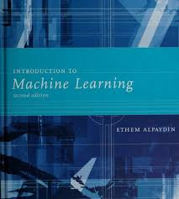
Course Materials and References
Introduction to Machine Learning with Python by Andreas C. Muller and Sarah Guido
Hands-On Machine Learning with Scikit-Learn and TensorFlow by Aurélien Géron
Introduction to Machine Learning by Ethem Alpaydın

Slide 5
Outline
NOT linearly separable Problems
Decision Trees
Decision Tree Terminology
Impurity
Tree Pruning
Naïve Bayes
Bayes
Bayes' Theorem
Numerical Example
Advantages of Naive Bayes
Disadvantages of Naive Bayes

Slide 6
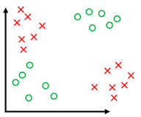
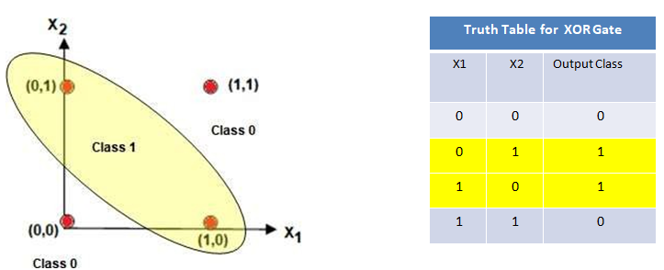
What if the data is NOT linearly separable?
Logistic regression gives one straight boundary.
What if we want boundaries that bend?

Slide 7
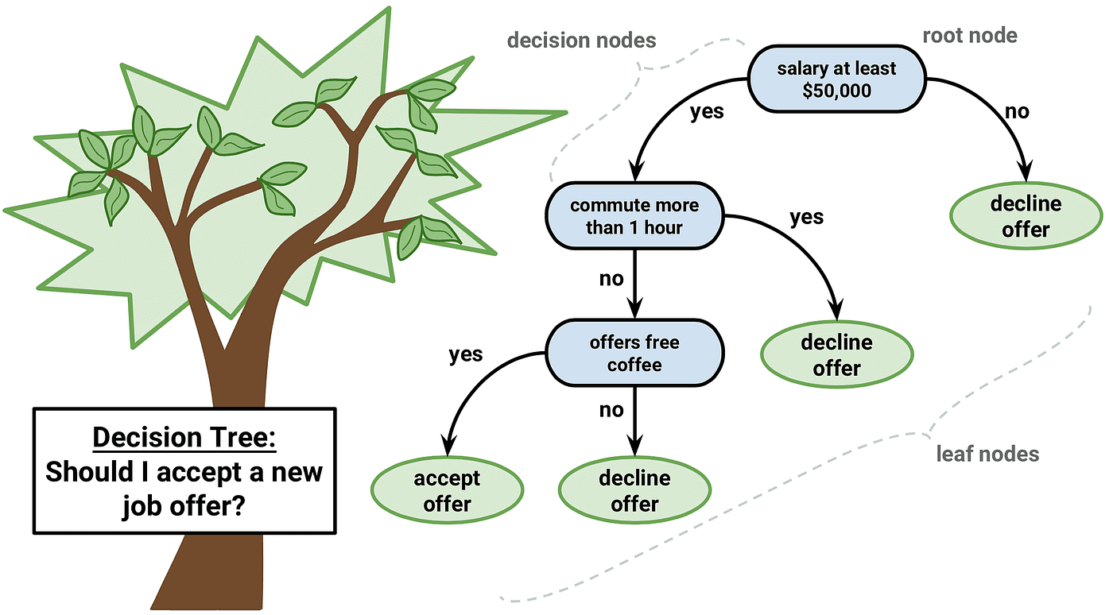
Decision Trees
A decision tree is a graphical representation of all the possible solutions to a decision based on a certain conditions.
A sequence of questions.
It’s just nested if-else rules.

Slide 8
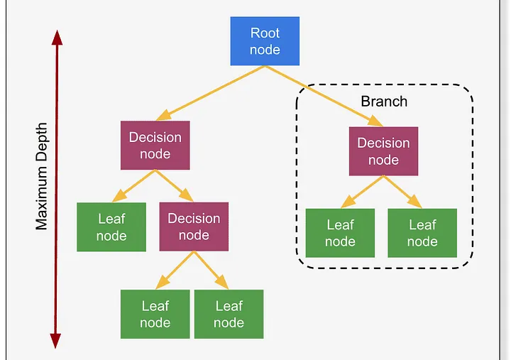
Decision Tree Terminology

Slide 9
Decision Tree Terminology
Root Node:
- Represents the entire dataset
Decision Nodes:
- The nodes where the dataset is further split based on a certain feature.
Leaf Nodes:
- They represent the final output or the decision of the model.
- They do not split further and contain the outcome of the decision path.
Branch:
- The connection between nodes, representing the outcome of a test.
Parent Node
Any node that splits into one or more branches
Child Node
- Created from a parent node after a split

Slide 10
Algorithm for Decision Tree Induction
Basic algorithm (a greedy algorithm)
– Tree is constructed in a top-down recursive divide-and-conquer manner
– At start, all the training examples are at the root
– Attributes are categorical (if continuous-valued, they are discretized in advance)
– Examples are partitioned recursively based on selected attributes
– Test attributes are selected on the basis of a heuristic or statistical measure (e.g., information gain)
Conditions for stopping partitioning
– All samples for a given node belong to the same class
– There are no remaining attributes for further partitioning – majority voting is employed for classifying the leaf
– There are no samples left

Slide 11
Example
Goal: Predict whether someone will like go to :.
Weekend | Weather | Parents | Money | Decision
W1 | Sunny | Yes | Rich | Cinema
W2 | Sunny | No | Rich | Tennis
W3 | Windy | Yes | Rich | Cinema
W4 | Rainy | Yes | Poor | Cinema
W5 | Rainy | No | Rich | Stay In
W6 | Rainy | Yes | Poor | Cinema
W7 | Windy | No | Poor | Cinema
W8 | Windy | No | Rich | Shopping
W9 | Windy | Yes | Rich | Cinema
W10 | Sunny | No | Rich | Tennis
There are 4 possible outputs:
Cinema, Tennis,
Stay In, Shopping.
6 instances of Cinema
2 instances of Tennis
1 instance of Stay In
1 instance of Shopping

Slide 12
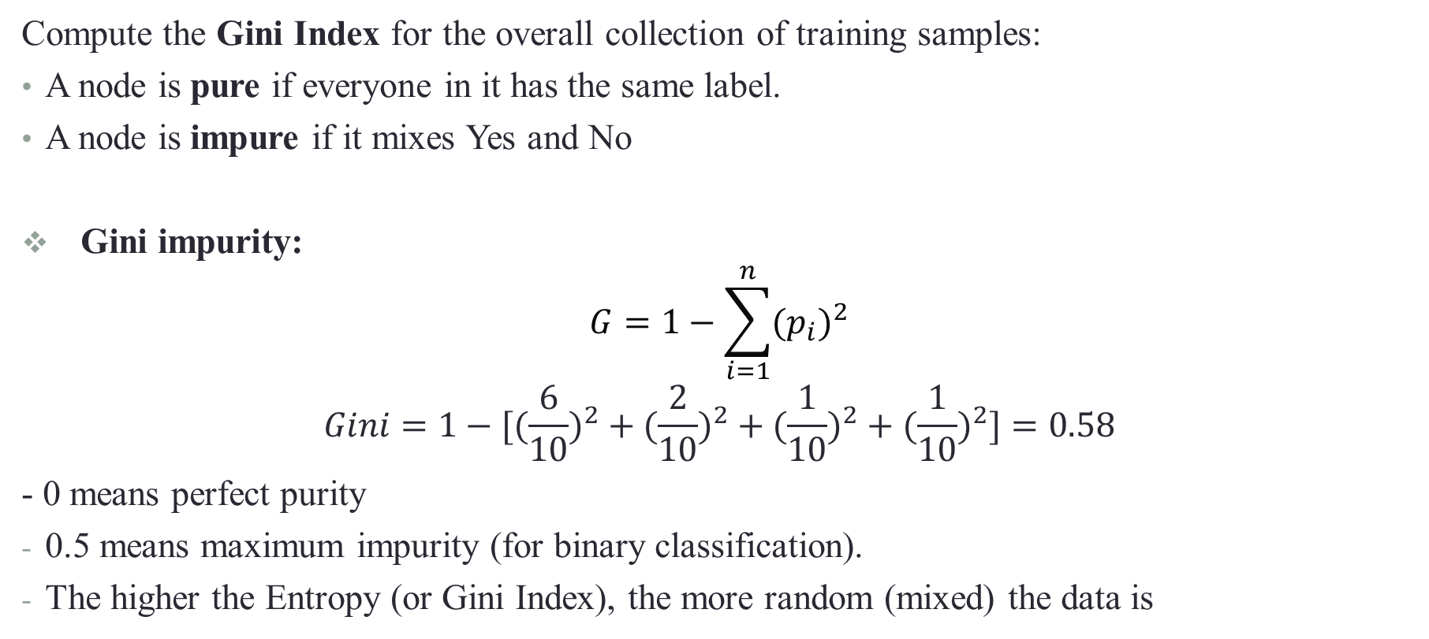
What Is Impurity?
Compute the Gini Index for the overall collection of training samples:
A node is pure if everyone in it has the same label.
A node is impure if it mixes Yes and No
Gini impurity:
$$G=1−\sum_{i=1}^{n}{{(p_{i})}^{2}}$$
$$Gini=1−[({\frac{6}{10})}^{2}+({\frac{2}{10})}^{2}+({\frac{1}{10})}^{2}+({\frac{1}{10})}^{2}]=0.58$$
- 0 means perfect purity
0.5 means maximum impurity (for binary classification).
The higher the Entropy (or Gini Index), the more random (mixed) the data is

Slide 13
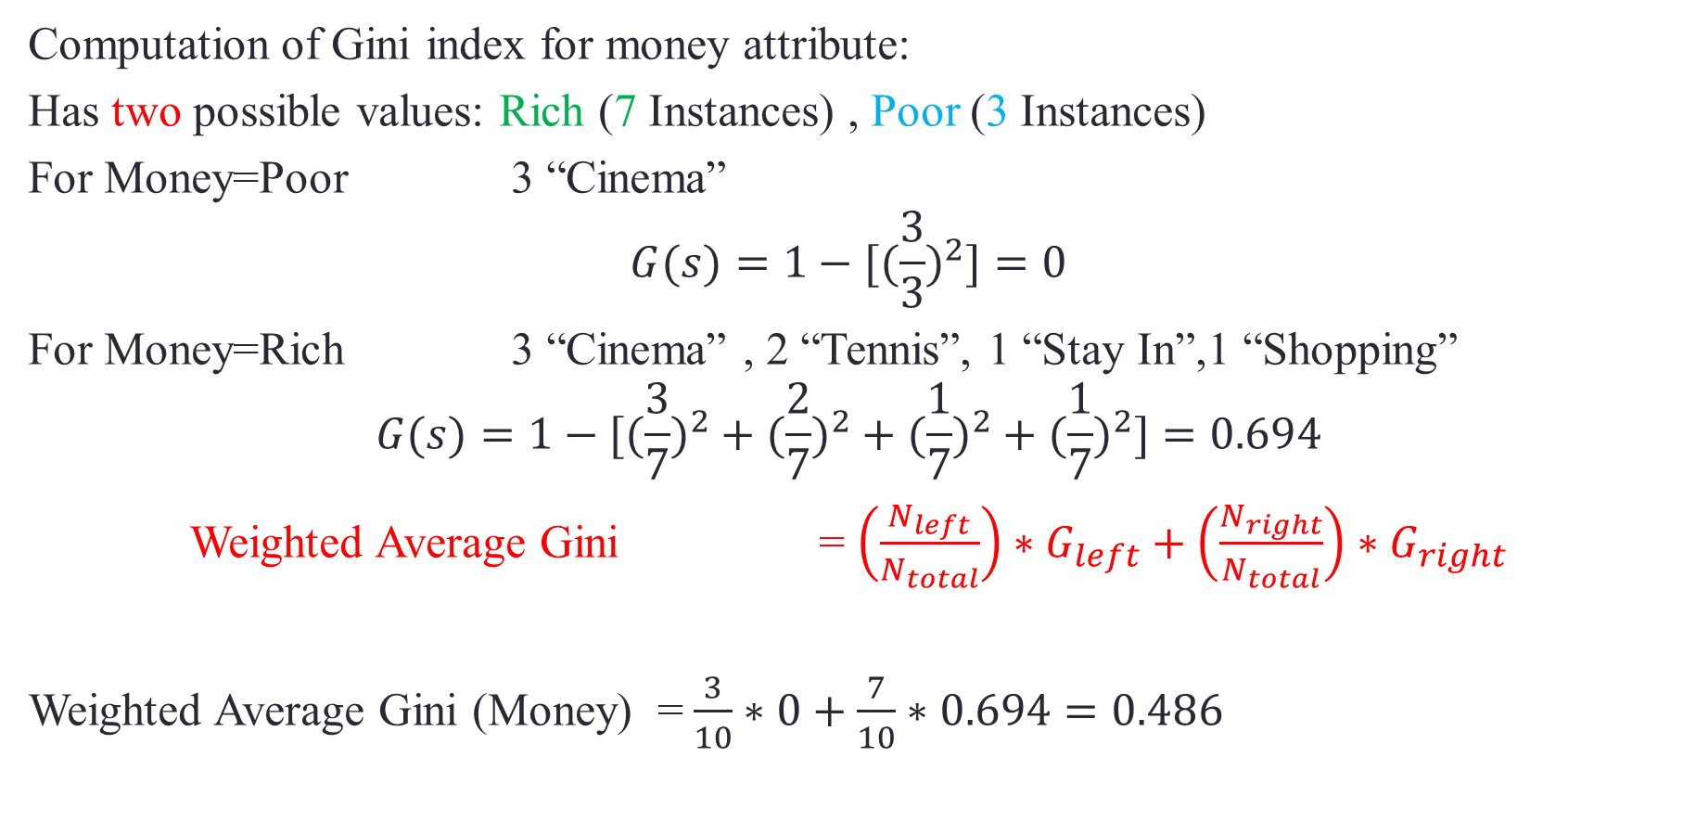
Compute Root Impurity
Computation of Gini index for money attribute:
Has two possible values: Rich (7 Instances) , Poor (3 Instances)
For Money=Poor 3 “Cinema”
$$G(s)=1−[({\frac{3}{3})}^{2}]=0$$
For Money=Rich 3 “Cinema” , 2 “Tennis”, 1 “Stay In”,1 “Shopping”
$$G(s)=1−[({\frac{3}{7})}^{2}+({\frac{2}{7})}^{2}+({\frac{1}{7})}^{2}+({\frac{1}{7})}^{2}]=0.694$$
Weighted Average Gini = $\left(\frac{N_{left}}{N_{total}}\right)∗G_{left}+\left(\frac{N_{right}}{N_{total}}\right)∗G_{right}$
Weighted Average Gini (Money) =$\frac{3}{10}∗0+\frac{7}{10}∗0.694=0.486$

Slide 14
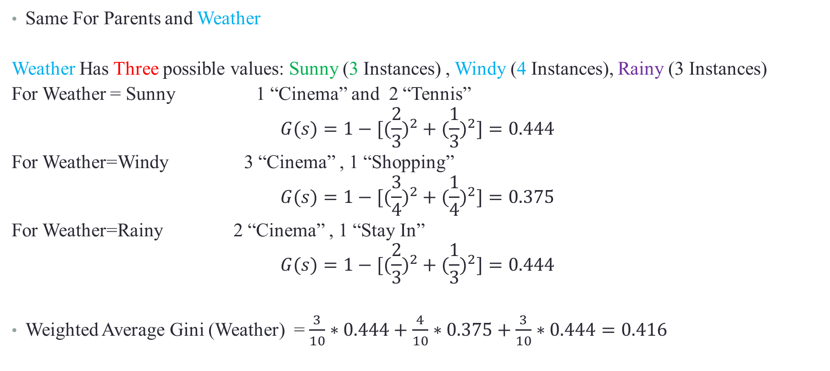
Same For Parents and Weather
Weather Has Three possible values: Sunny (3 Instances) , Windy (4 Instances), Rainy (3 Instances)
For Weather = Sunny 1 “Cinema” and 2 “Tennis”
$$G(s)=1−[({\frac{2}{3})}^{2}+({\frac{1}{3})}^{2}]=0.444$$
For Weather=Windy 3 “Cinema” , 1 “Shopping”
$$G(s)=1−[({\frac{3}{4})}^{2}+({\frac{1}{4})}^{2}]=0.375$$
For Weather=Rainy 2 “Cinema” , 1 “Stay In”
$$G(s)=1−[({\frac{2}{3})}^{2}+({\frac{1}{3})}^{2}]=0.444$$
Weighted Average Gini (Weather) =$\frac{3}{10}∗0.444+\frac{4}{10}∗0.375+\frac{3}{10}∗0.444=0.\text{416}$

Slide 15

For Money - Gini index =$\frac{3}{10}∗0+\frac{7}{10}∗0.694=0.486$
For Weather - Gini index =$\frac{3}{10}∗0.444+\frac{4}{10}∗0.375+\frac{3}{10}∗0.444=0.\text{416}$
For Parents - Gini index =$\frac{5}{10}∗0+\frac{5}{10}∗0.72=0.$36 ✓
Parents is selected as it has the smallest Gini Index

Slide 16
Parents
Yes
No
Weekend | Weather | Parents | Money | Decision
W1 | Sunny | Yes | Rich | Cinema
W3 | Windy | Yes | Rich | Cinema
W4 | Rainy | Yes | Poor | Cinema
W6 | Rainy | Yes | Poor | Cinema
W9 | Windy | Yes | Rich | Cinema
Weekend | Weather | Parents | Money | Decision
W2 | Sunny | No | Rich | Tennis
W5 | Rainy | No | Rich | Stay In
W7 | Windy | No | Poor | Cinema
W8 | Windy | No | Rich | Shopping
W10 | Sunny | No | Rich | Tennis
No computation is needed here since it is always Cinema.

Slide 17
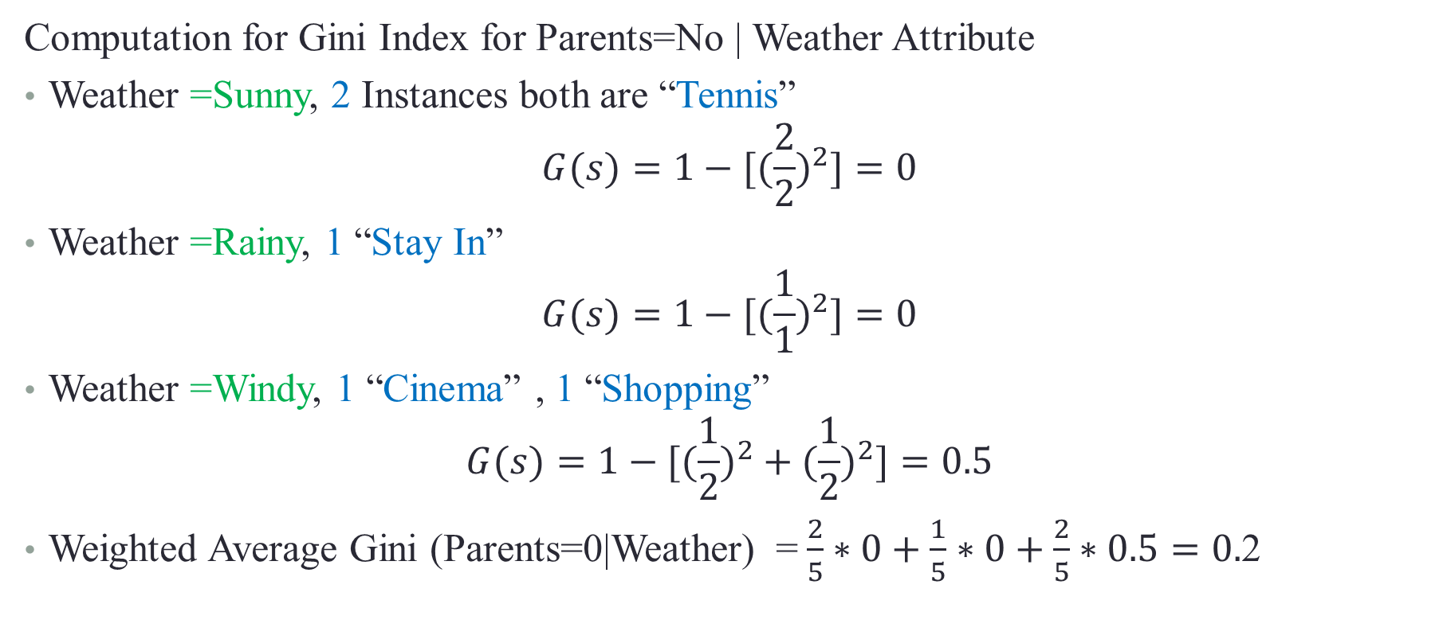
Computation for Gini Index for Parents=No | Weather Attribute
Weather =Sunny, 2 Instances both are “Tennis”
$$G(s)=1−[({\frac{2}{2})}^{2}]=0$$
Weather =Rainy, 1 “Stay In”
$$G(s)=1−[({\frac{1}{1})}^{2}]=0$$
Weather =Windy, 1 “Cinema” , 1 “Shopping”
$$G(s)=1−[({\frac{1}{2})}^{2}+({\frac{1}{2})}^{2}]=0.5$$
Weighted Average Gini (Parents=0|Weather) =$\frac{2}{5}∗0+\frac{1}{5}∗0+\frac{2}{5}∗0.5=0.$2

Slide 18
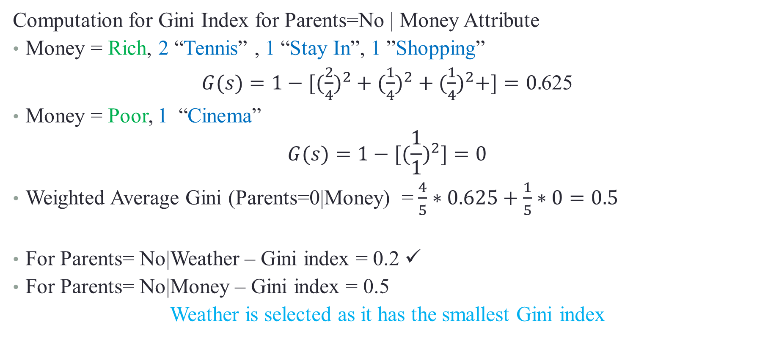
Computation for Gini Index for Parents=No | Money Attribute
Money = Rich, 2 “Tennis” , 1 “Stay In”, 1 ”Shopping”
$G(s)=1−[({\frac{2}{4})}^{2}+({\frac{1}{4})}^{2}+({\frac{1}{4})}^{2}+]=0.$625
Money = Poor, 1 “Cinema”
$$G(s)=1−[({\frac{1}{1})}^{2}]=0$$
Weighted Average Gini (Parents=0|Money) =$\frac{4}{5}∗0.625+\frac{1}{5}∗0=0.5$
For Parents= No|Weather – Gini index = 0.2 ✓
For Parents= No|Money – Gini index = 0.5
Weather is selected as it has the smallest Gini index

Slide 19
Weekend | Weather | Parents | Money | Decision
W2 | Sunny | No | Rich | Tennis
W10 | Sunny | No | Rich | Tennis
For Parent =No & Weather =Sunny , All instances are Tennis
Weekend | Weather | Parents | Money | Decision
W5 | Rainy | No | Rich | Stay In
For Parent =No & Weather =Rainy , All instances are Stay In
Weekend | Weather | Parents | Money | Decision
W7 | Windy | No | Poor | Cinema
W8 | Windy | No | Rich | Shopping
For Parent =No & Weather =Windy, We need to Split.

Slide 20
Parents
Cinema
Weather
Windy
Rainy
Sunny
Stay In
Tennis
Money
Rich
Poor
Shopping
Cinema

Slide 21
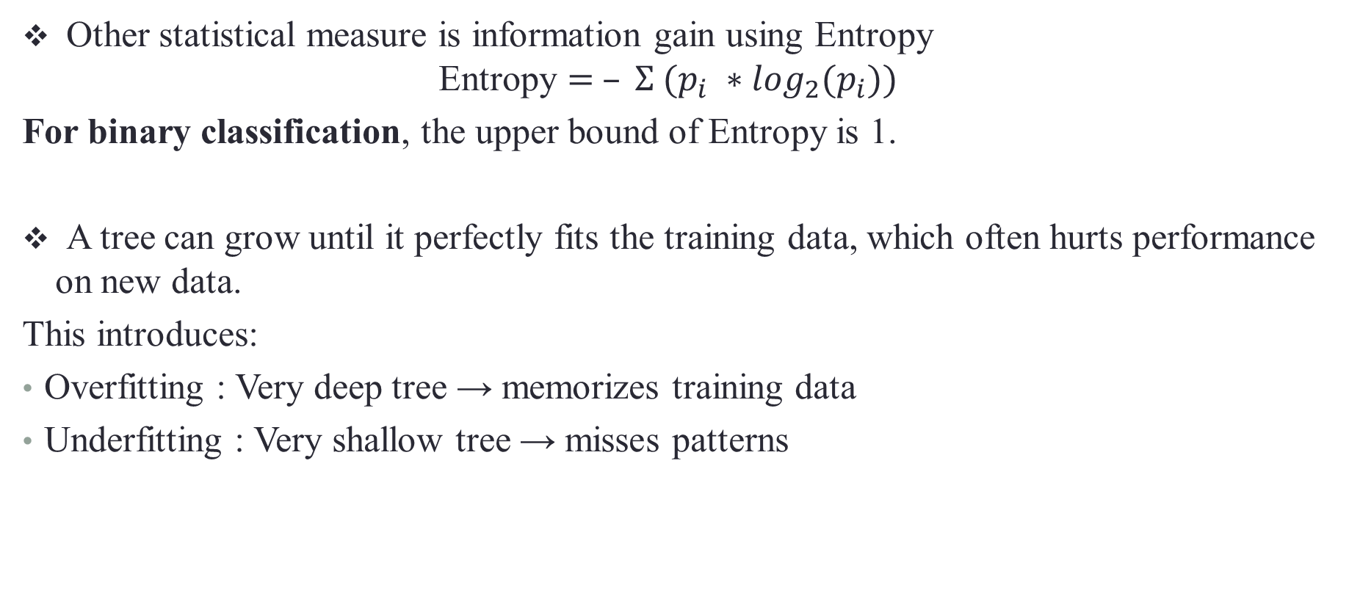
Other statistical measure is information gain using Entropy
$$\text{Entropy}= – Σ (p_{i} ∗\log_{2}(p_{i}))$$
For binary classification, the upper bound of Entropy is 1.
A tree can grow until it perfectly fits the training data, which often hurts performance on new data.
This introduces:
Overfitting : Very deep tree → memorizes training data
Underfitting : Very shallow tree → misses patterns

Slide 22
Tree Pruning
To fix overfitting we use Pruning
Pre-pruning (early stopping)
Stop growing the tree when:
Depth > threshold
Samples < threshold
Post-pruning;
Grow full tree → then remove weak branches.

Slide 23
Naïve Bayes
A probabilistic classifier
Predicts the category of a data point using Bayes' Theorem
Assumes that all features are independent of each other (Naïve Assumption) → Each feature contributes to the predictions with no relation between each other.
Used in text classification and sentiment analysis.
Principle:
- Calculates the probability of a data point belonging to each class based on the observed features.
- Then predicts the class with the highest probability as the final prediction.

Slide 24
Assumption of Naive Bayes
Feature independence:
We assume that each feature (or piece of information) in the data does not affect any other feature. In reality, this assumption isn’t always true.
Continuous features are normally distributed:
If a feature is continuous, then it is assumed to be normally distributed within each class.
Discrete features have multinomial distributions:
If a feature is discrete, then it is assumed to have a multinomial distribution within each class.
Features are equally important:
All features are assumed to contribute equally to the prediction of the class label.
No missing data:
The data should not contain any missing values.

Slide 25
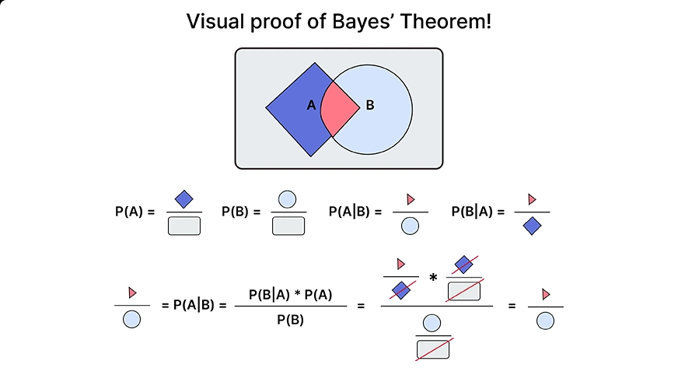
Bayes' Theorem
Helps in calculating conditional probabilities.
Conditional probability: is the probability of an event occurring given that another event has already occurred.

Slide 26
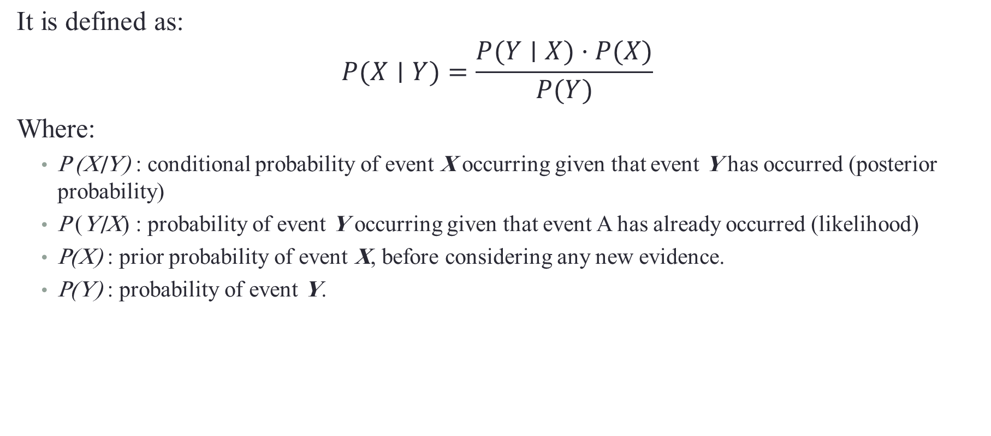
$\text{D}\text{efin}\text{ition}$
$$\text{It} \text{is} \text{defined} \text{as}\text{:}$$
$$P(X∣Y)=\frac{P(Y∣X)⋅P(X)}{P(Y)}​$$ Where:
P (X∣Y) : conditional probability of event X occurring given that event Y has occurred (posterior probability)
P (Y∣X) : probability of event Y occurring given that event A has already occurred (likelihood)
P(X) : prior probability of event X, before considering any new evidence.
P(Y) : probability of event Y.

Slide 27
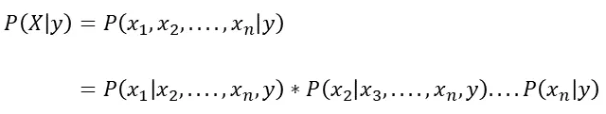

Using the chain rule, the likelihood P(X ∣ y) can be decomposed as:
But because of the Naive’s conditional independence assumption, the conditional probabilities are independent of each other

Slide 28
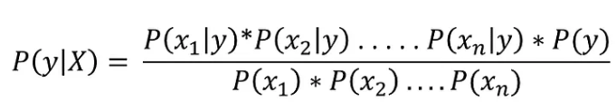
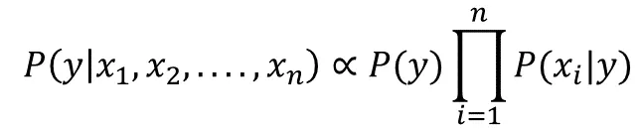
Thus, by conditional independence, we have:
And as denominator remains constant for all values, the posterior probability can then be:

Slide 29
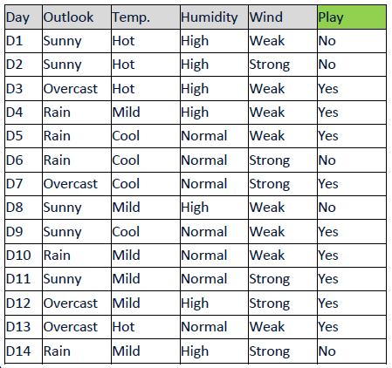
Example
Given Outlook, Temperature, Humidity and Wind Information, we want to carry out prediction for Play: Yes or No.
Mathematically, which one is greater
- P(Play Yes | Outlook, Temp., Humidity, Wind)
- P(Play No | Outlook, Temp., Humidity, Wind)
Predict for Sunny outlook, High humidity, Cool temperature and Weak wind.
• Predict the most likely.

Slide 30
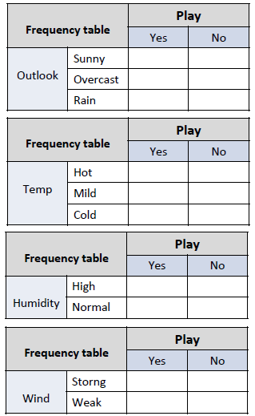
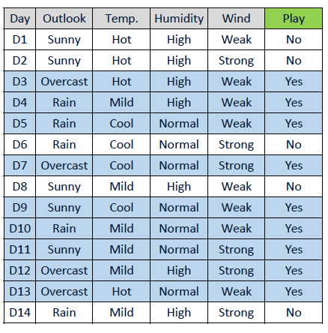
Calculate the frequency table for all features
Training

Slide 31
Frequency Table |  | Play
 |  | Yes | No
Outlook | Sunny | 2 | 3
 | Overcast | 4 | 0
 | Rain | 3 | 2
Calculate the frequency table for all features
Frequency Table |  | Play
 |  | Yes | No
Temp | Hot | 2 | 2
 | Mild | 4 | 2
 | Cold | 3 | 1
Training
Frequency Table |  | Play
 |  | Yes | No
Humidity | High | 3 | 4
 | Normal | 6 | 1
Frequency Table |  | Play
 |  | Yes | No
Wind | Strong | 3 | 3
 | Weak | 6 | 2

Slide 32
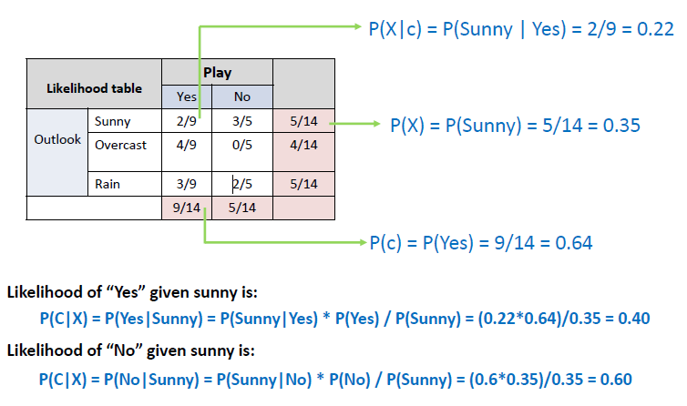
Calculate the likelihood table for all features

Slide 33
Likelihood Table |  | Play
 |  | Yes | No
Temp | Hot | 2/9 | 2/5 | 4/14
 | Mild | 4/9 | 2/5 | 6/14
 | Cold | 3/9 | 1/5 | 4/14
 |  | 9/14 | 5/14
Likelihood Table |  | Play
 |  | Yes | No
Humidity | High | 3/9 | 4/5 | 7/14
 | Normal | 6/9 | 1/5 | 7/14
 |  | 9/14 | 5/14
P(Yes|High) = (0.33*0.64)/0.5 = 0.42
P(No|High) = (0.8*0.35)/0.5 = 0.56
P(Yes|Cold) = P(Cold|Yes) * P(Yes) / P(Cold)
= (0.33*0.64)/0.28 = 0.75
P(No|Cold) = (0.2*0.35)/0.28 = 0.25
Likelihood Table |  | Play
 |  | Yes | No
Wind | Strong | 3/9 | 3/5 | 6/14
 | Weak | 6/9 | 2/5 | 8/14
 |  | 9/14 | 5/14
P(Yes|Weak) = (0.66*0.64)/0.57= 0.74
P(No|Weak) = (0.4*0.35)/0.57 = 0.25

Slide 34
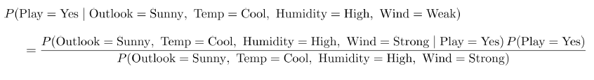
Test Data:
Naïve Assumption:
Feature are mutually independent given the label!
P(Outlook Sunny, Temp Cool, Humidity High, Wind = Strong | Play = Yes)
= P(Outlook=Sunny|Play = Yes) P(Temp= Cool|Play = Yes) P(Humidity= High|Play = Yes) P(Wind= Strong|Play = Yes)

Slide 35
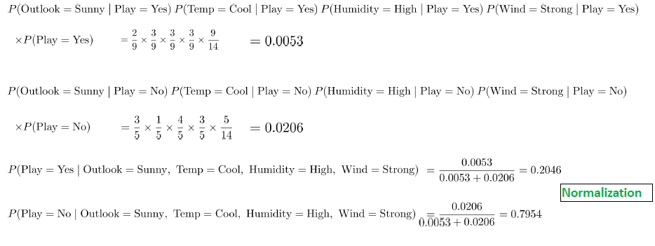
Play = No is more likely!

Slide 36
Advantages of Naive Bayes
1. This algorithm works very fast and can easily predict the class of a test dataset.
2. You can use it to solve multi-class prediction problems as it’s quite useful with them.
3. Naive Bayes classifier performs better than other models with less training data if the assumption of
independence of features holds.
4. If you have categorical input variables, the Naive Bayes algorithm performs exceptionally well in
comparison to numerical variables.

Slide 37
Disadvantages of Naive Bayes
If your test data set has a categorical variable of a category that wasn’t present in the training data set, the Naïve Bayes model will assign it zero probability and won’t be able to make any predictions in this regard.
This phenomenon is called ‘Zero Frequency,’ and you’ll have to use a smoothing technique to solve this problem.
2. It assumes that all the features are independent. While it might sound great in theory, in real life, you’ll hardly find a set of independent features.

